Slide 1
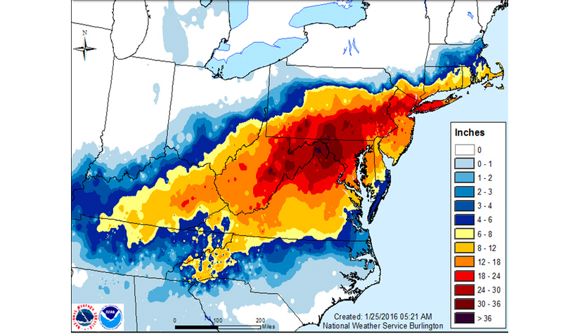
LTC RISE Winter Storm Tabletop Exercise
[For LTC RISE Program Participants Use Only]

Slide 2
Agenda
EXERCISE
Introductions
Modules
1–Pre-event preparedness
2–Response
3–Recovery / Mitigation
Hotwash
2

Slide 3
Exercise Rules
EXERCISE
Create a quality, no fault learning environment.
Provide a tool for emergency planning, a forum for discussing and developing emergency plans.
Empower our organizations through the healthcare coalition.
Encourage coordination within and outside of the facility.
3

Slide 4
Exercise Objectives
Validate the facility / organizational / regional emergency operations plan components for adverse and severe weather.
Understand the regional information sharing procedures and platforms.
Identify strategies for continuity of health care service delivery.
Identify strategies for coordination of health care system recovery.

Slide 5
Rules for Players
Relax – this is a no-fault, low stress exercise.
Respond based on your current capability.
Allow for artificialities of the scenario – it’s a tool.
Feel free to improvise – think outside the box.
Exercise participant safety takes priority over exercise events.
Real-world emergency actions take priority over exercise actions.
For an emergency that requires assistance, use the phrase “real-world emergency.”
All exercise communications will begin and end with the statement “This is an exercise.”
Avoid sending exercise communications to organizations that are not aware of the exercise or are not actively participating.
Exercise players who place telephone calls or initiate radio communication with the SimCell must identify the organization or individual with whom they wish to speak.

Slide 6
Scenario: Winter Storm
Blizzard conditions
Wind
Ice accumulation and cold air

Slide 7
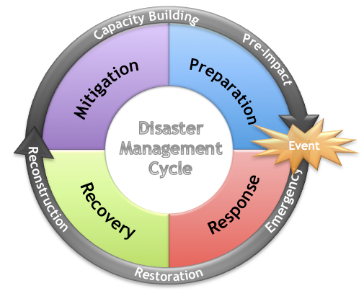
Emergency Management
Prepare and Protect
Respond
Recover
Mitigate

Slide 8
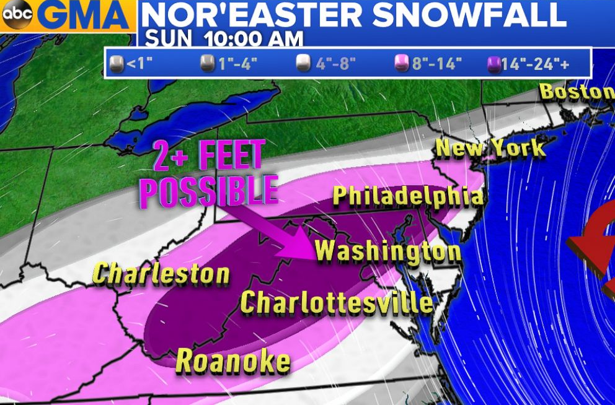
Module 1– Prepare and Protect
Status of plan and activation
Gather the planning team
Who’s on the team?
Where do you get your information?
What if a no-notice event occurs?
Assess hazards, prepare facilities and employees
What are our greatest vulnerabilities?
Confirm and check ingress and egress routes
Stock and check supplies, equipment, medications and linen
Monitor storm development
Activate Emergency Response Teams
What comprises the teams?
Coordinate with local and state emergency managers and the HCC

Slide 9
Prepare & Protect– Discussion
What preparedness actions have you been taking to prepare for the storm?
Will an Incident Command be established at this point? What would trigger this decision? What are the known facts right now?
What does the emergency operations plan recommend for adverse weather?
What are some reasonable assumptions and what assumptions should be avoided?
What warning and notification systems are available for the organization to maintain communication with staff and families as well as with other facilities?
How do you validate information received?
Who need to be involved at this point?
What are the incident and resource priorities?

Slide 10
Prepare & Protect– Discussion
What does the facility / organization need from utility providers?
What needs to be prepared in advance for distribution, in case of power outage or will they be produced as needed?
What roads need to be opened first on your property?
What are the hazards?
Who is your team? Internally and externally?
How will you communicate? What if systems fail?
What are your unmet needs, for supplies, medications, staff, etc.?
What are needs of employees and their families, families, members? How do we protect them?
What are needs for protecting the organization?
Who do we contact and inform, internally and externally?
What can we do now to recover more quickly later?
Describe your overall planning effort.

Slide 11
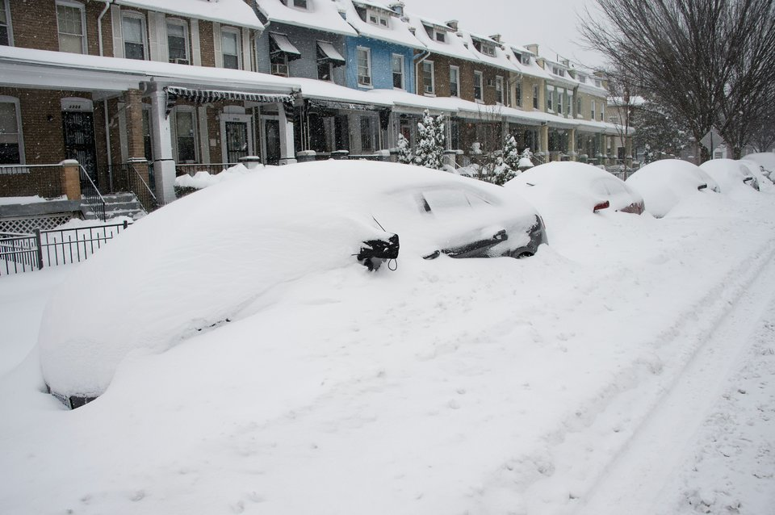
Module 2- Respond
Mobilize and position emergency equipment
Power outage concerns
Provisions for food, water, shelter, medical
Initiate organization continuity plan
Assess and restore damaged services and systems
Coordinate with local responders, government agencies, and other private organizations
Notes:
[TIMING OF SLIDE: 8 minutes]
FACILITATOR: The bullets shown here are actions taken in the response stage after a disaster. When we have notice of a probable disaster such as an approaching hurricane, response begins before the disaster strikes. This phase involves mobilizing and positioning emergency equipment; confirming location of employees/constituents and getting them out of danger; providing needed food, water, shelter, and medical services; initiating organization continuity actions; and identifying any barriers to bringing damaged services and systems back on line.
Local responders, government agencies, and private organizations take action, ideally working as a team following planning done well before the emergency. When the destruction goes beyond local and State capabilities, the state Governor requests Federal assistance and support.
Organizations like ours will be focused on such actions as: Keeping employees safe; Executing emergency plans; Securing facilities; Coordinating and Supporting First Responders; Assisting our community at large if time and resources allow.
In a hurricane scenario, state and federal agencies will be working to: Deploy first responders; Perform Search and Rescue; Prioritize life-saving measures ; Maintain shelters; Distribute food, water and supplies; Roll out Emergency Management Assistance Compact (EMAC); and Provide situational awareness to the public-private response team.

Slide 12
Respond - Discussion
What are your response priorities, and would incident objectives be revised at this point?
How are you gathering situational awareness at this point? How will a common operating picture be maintained within the organizational structure?
What types of communications and coordination with other organizations would need to occur?
What additional resources are needed? How will you work to prioritize your facility for power restoration?
What entities will you be coordinating with at this point and who may be reaching out to you for assistance?
How are communications and emergency instructions to the staff being handled? What steps are being taken to deal with rumors? What equipment is needed?
Notes:
[TIMING OF SLIDE: 20-30 minutes]
[FACILITATOR leads a discussion, using some or all of these questions. Capture contributed ideas on butcher paper, laptop or other media. In addition to these general questions, FACILITATOR can prompt the participants with more specific questions customized to your organization.]
What equipment do we need and who’s in charge?
What’s our evacuation plan?
How do we distribute emergency supplies?
How will we restore damaged services and systems?
Who is the Point of Contact for local responders, government agencies, and other impacted private organizations? we coordinate our efforts with community response?
If looting affects our organization or neighborhood, what do we do? Including, what do we do when the emergency scene is also a crime scene?
What tasks must be completed immediately, and by whom?
How will we notify employees, responders, neighbors, government, community, media, and others of any emergency conditions at our facilities?
How will we communicate if certain communications systems are down?

Slide 13
Respond - Discussion
What infrastructure systems are most at risk and which will be the most critical to restore? How is this decision made? Who’s in charge?
What areas of your response plan identify issues related to personal (staff) protection and supporting facility operations during hazardous conditions? What role do policy- and decision-makers play in enforcing these guidelines?
What’s your plan (now and immediately following)?
How do we distribute the team that is there to effectively meet the daily need? Supplies/ Equipment?
Who can help restore damaged services/systems?
Notes:
[TIMING OF SLIDE: 20-30 minutes]
[FACILITATOR leads a discussion, using some or all of these questions. Capture contributed ideas on butcher paper, laptop or other media. In addition to these general questions, FACILITATOR can prompt the participants with more specific questions customized to your organization.]
What equipment do we need and who’s in charge?
What’s our evacuation plan?
How do we distribute emergency supplies?
How will we restore damaged services and systems?
Who is the Point of Contact for local responders, government agencies, and other impacted private organizations? we coordinate our efforts with community response?
If looting affects our organization or neighborhood, what do we do? Including, what do we do when the emergency scene is also a crime scene?
What tasks must be completed immediately, and by whom?
How will we notify employees, responders, neighbors, government, community, media, and others of any emergency conditions at our facilities?
How will we communicate if certain communications systems are down?

Slide 14
Build an Organizational Structure

Slide 15
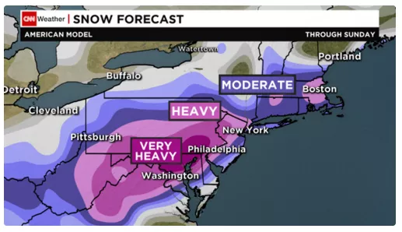
What is the response strategy?

Slide 16
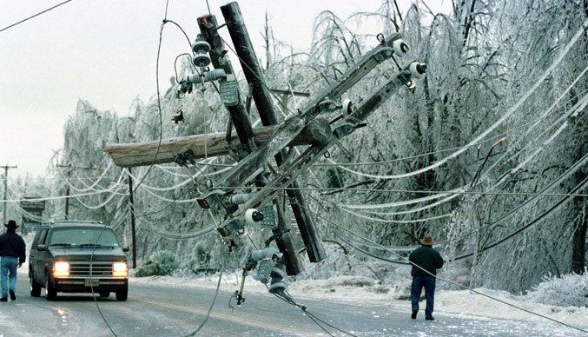
Module 3- Recovery (and Mitigation)
The organization could be heavily impacted, directly, or indirectly such as if the supply chain is disrupted or our employees are displaced from their homes.
Water, fuel, and electricity may not be available.
Employees could have damaged homes, or remain home tending to family and to children out of school.
Physical and mental health of employees could be a concern.
Notes:
[TIMING OF SLIDE: 8 minutes]
FACILITATOR: Recovery is the task of rebuilding after a disaster. This process can take months, even years and require rebuilding of services and infrastructure, facilities and operations, and the lives and livelihoods of many thousands of people. Recovery planning identifies the long-range actions needed to return the organization to its normal operations as quickly and completely as possible, and may involve: Medical issues; Psychological issues; Infrastructure issues; Liability issues; Insurance issues; Documentation issues.
An organization like ours will typically: Wait for word to return; Assess damages and take pictures; Compile and report damages to our insurance company; Clean up; Coordinate efforts with public sector recovery team
States will be working to: Reestablish infrastructure; Implement temporary disaster housing plan; Lead the recovery; Budget for long-term recovery
FEMA and federal partners will be working to: Produce Preliminary Damage Assessments; Publicize federal assistance available; Maintain Joint Field Office in support of state; Establish long-term recovery effort where appropriate; Support communities to return to pre-disaster tax-base level within five years.

Slide 17
Recovery- Discussion
When should the response transform into recovery operations? What issues will result from the transformation from response to recovery operations?
How will your organizational structure change during the recovery phase?
How are you helping to identify unmet needs of your employees affected by the storm? What behavioral health programs should be implemented for your employees?
What has the community learned about being better prepared?
What changes need to be made in plans and procedures to mitigate this situation?
How will demobilization be established/implemented?
How could this affect your operations?
How do you ensure continuity of operations (COOP)?
Can you operate without municipal services or utilities?
What is the long-term sustainability of generators and other back-up utilities?
Notes:
[TIMING OF SLIDE: 20-30 minutes]
[FACILITATOR leads a discussion, using some or all of these questions. Capture contributed ideas on butcher paper, laptop or other media. In addition to these general questions, FACILITATOR can prompt the participants with more specific questions customized to your organization.]
What are long term environmental effects?
How could this affect our operations?
How do we ensure continuity of operations (COOP)?
Can we operate without municipal services or utilities?
Do we have generators and other back-up utilities?
Will our employees miss work, e.g. to attend to family if schools are closed?
How will we repair structural and physical damage?
How will we restore disrupted services?
How will we clean the facility and remove all health and safety hazards?
How will we resume operations, toward returning to normal operations? (especially important if a portion of the building is damaged to such a degree that operations must be relocated temporarily.)
How will we document any damaged facilities or equipment on video or photographs?
How will we track staff and volunteer time and labor involved in the cleanup?
Do we have policies to allow flexibility to displaced employees, such as policies for working half-days, alternate sites, mobile sites, and teleworking?

Slide 18
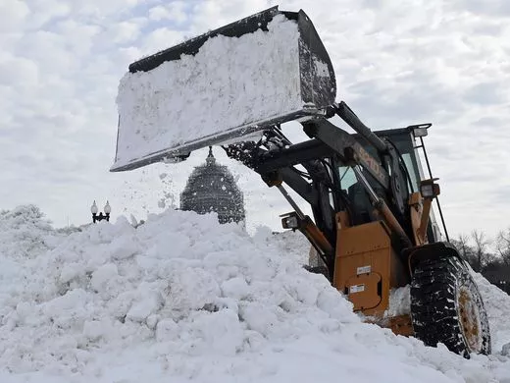
Mitigation- Discussion
What hazards have been identified in the organization that pose a risk to sustainable operations?
What steps can we take to mitigate risks?
What steps is the community taking to mitigate community-wide risks?
How can your organization work with local officials?
Notes:
[TIMING OF SLIDE: 8 minutes]
[NOTE: Slide is optional, depending on available time.]
FACILITATOR: Hazard Mitigation means any action taken to reduce or eliminate the long-term risk to human life and property from hazards.
Some hazards cannot be mitigated; others are too costly to mitigate.
Many nonstructural hazards in a facility can be mitigated easily and inexpensively.
Mitigation of community risks is probably beyond the control of our organization’s officials. However, our emergency planning teams should work closely with the local Emergency Manager and responders to learn:
What hazards have been identified in the community.
What steps the community is taking to mitigate community-wide risks.
How our organization’s officials can help.
Experts in emergency management and response, risk management, structural engineering, and psychological tragedy response may suggest ways to mitigate hazards at our facilities.
After our planners have the necessary information about existing hazards and mitigation possibilities, we can identify the costs of mitigation and steps to be taken.

Slide 19
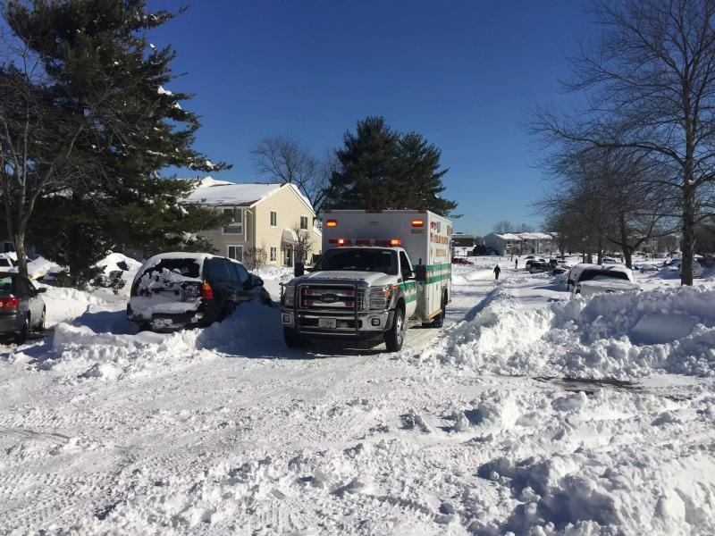
Hot Wash
What have you learned during this exercise?
Name three organizational strengths.
Name three organizational weaknesses/gaps.
What should the next steps in planning and preparing?
List and prioritize three short-term and three long-term actions for follow-up.
Notes:
[TIMING OF SLIDE: 20 minutes]
[NOTE: This is an open discussion that occurs immediately after the tabletop exercise and is conducted by the facilitator. The objective of the hot wash is to review events or key decisions that took place during the exercise and to provide an opportunity for participants to describe any immediate lessons learned and to identify barriers/gaps in mounting an effective response. All participants are free to contribute and are encouraged to do so. Consider soliciting feedback on this exercise and/or the FACILITATORs’ ability through an evaluation survey at the end of the hot wash.]

